Slide 1


Rotimi Dare
4/18/2023

Slide 2

Outline
Executive Summary
Introduction
Methodology
Results
Conclusion
Appendix

Slide 3
Executive Summary
Summary of methodologies
Data Collection through API
Data Collection with Web Scraping
Data Wrangling (Manipulation)
Exploratory Data Analysis with SQL
Exploratory Data Analysis with Data Visualization
Interactive Visual Analytics with Folium
Machine Learning Prediction
Summary of all results
Exploratory Data Analysis result
Screenshots of interactive analytics
Predictive Analytics result

Slide 4
Introduction
This project is focused on the commercial space transport service, SpaceX, who have relatively succeeded in the space program due to their relatively inexpensive rocket launches. The aim of the project is to use the SpaceX datasets to determine the cost of a launch by predicting if the first stage of the rocket would land. The data sets were collected via an API. I used SQL and Python primarily for the whole project. Data Wrangling and EDA and visualization were done to understand some of the variables in the dataset. Folium was used in plotting the sites of the launches and other relative information. Finally, a Machine Learning model was created to predict the success of failure of each rocker launches using different classification algorithms.
The results gotten would be presented in details in the subsequent slides for your perusal.

Slide 5

Section 1

Slide 6
Methodology
Executive Summary
Data collection methodology:
Data was collected by web scraping and via spacex API
Perform data wrangling
Data was processed using pandas
Perform exploratory data analysis (EDA) using visualization and SQL
Perform interactive visual analytics using Folium and Plotly Dash
Perform predictive analysis using classification models
How to build, tune, evaluate classification models

Slide 7
Data Collection
The data was collected by different methods:
Via SpaceX API
This requires me sending an API request to the SpaceX server and getting a json response that can be parsed and analyzed. This was done using the request library.
Via Webscraping
Here, the data was collected by scraping Wikipedia page for information containing SpaceX rockets using beautiful soup library. The scraped html data is then parsed using html parser and the necessary data were extracted and used for the analysis.

Slide 8
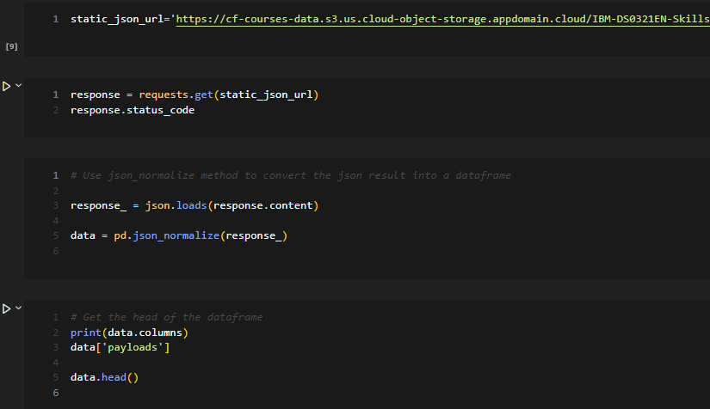
Data Collection – SpaceX API
github: https://github.com/emmanuelani/ibm_ds_capstone/blob/master/jupyter-labs-spacex-data-collection-api.ipynb

Slide 9
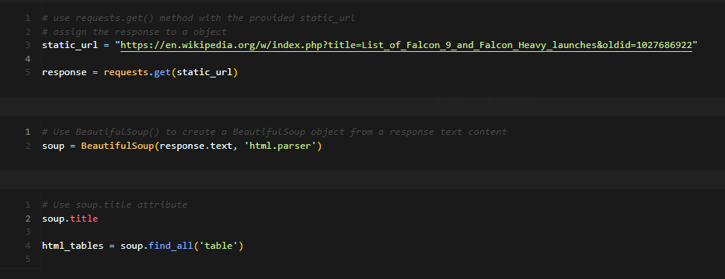
Data Collection - Scraping
Github url: https://github.com/emmanuelani/ibm_ds_capstone/blob/master/Webscraping.ipynb

Slide 10
Data Wrangling

Slide 11
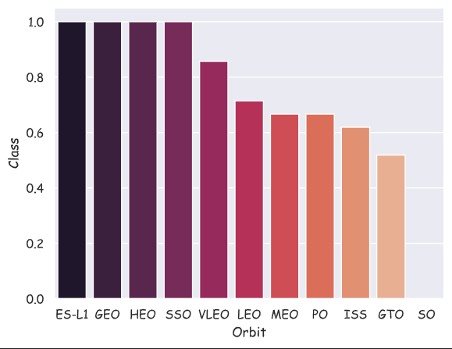
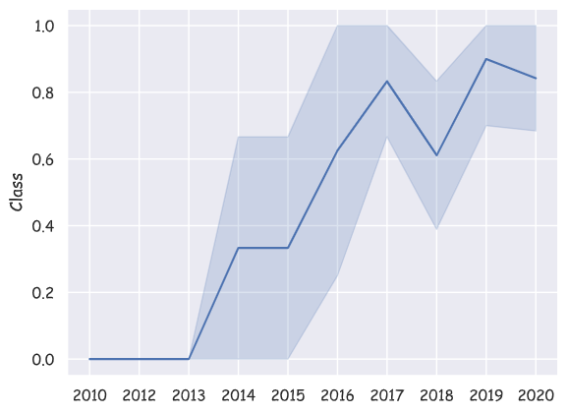
EDA with Data Visualization
Bar charts and Line charts were plotted. The bar chart was used to visualize the success rate for each orbit while the line chart was used to show the trend of success rates over the years.
Github: https://github.com/emmanuelani/ibm_ds_capstone/blob/master/jupyter-labs-eda-dataviz.ipynb

Slide 12
EDA with SQL
The data used for the EDA was loaded into SQL Server and then a connection was made to the server using pyodbc module.
A cursor object was then created from the connection string which was used to run the SQL queries in python.
The link below would provide a more detailed look into the EDA using SQL
Github: https://github.com/emmanuelani/ibm_ds_capstone/blob/master/SQL%20EDA.ipynb

Slide 13
Build an Interactive Map with Folium
Using folium API, I was able to create interactive maps that visualized the launch sites.
I was also able to display all the different launches at the different sites and label the successful and the failed launches using MarkerCluster object.
I used MousePosition to get the coordinates of coastline, railway, highway and a city and calculated the distance between the launch centre and these locations.
Github: https://github.com/emmanuelani/ibm_ds_capstone/blob/master/Launch%20Sites%20Locations%20Analysis%20using%20Folium.ipynb

Slide 14
Predictive Analysis (Classification)
Using several classification algorithm. I was able to find the best model that most accurately predicted if the falcon 9 rocket would land or not.
Using standard scaler, the data was normalized before passing it over to the algorithms.
It was then split into train and test data using train_test_split function.
After training the data on different algorithms. The accuracy score of each model was plotted on a bar chart and Decision tree came out to be the model that performed best.
Github: https://github.com/emmanuelani/ibm_ds_capstone/blob/master/Prediction%20using%20Machine%20Learning.ipynb

Slide 15

Section 2

Slide 16
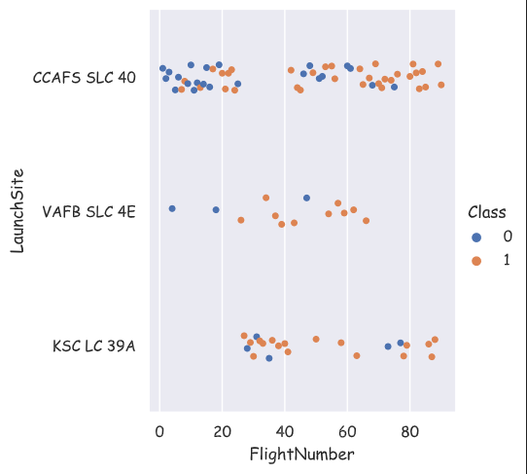
Flight Number vs. Launch Site
We can see clearly from the chart the number of flights that succeeded and failed in each launch site. KSC LC 39A and VAFB SLC 4E clearly had lesser number of flights and a higher success rate than CCAFS SLC 40.

Slide 17
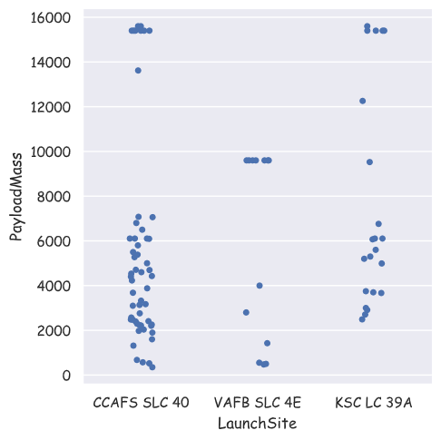
Payload vs. Launch Site
We can see clearly from the chart the launch sites and their distribution of payload masses for each launch. CCAFS SLC 40 and KSC LC 39A both had flights with payload mass above 15000kg

Slide 18
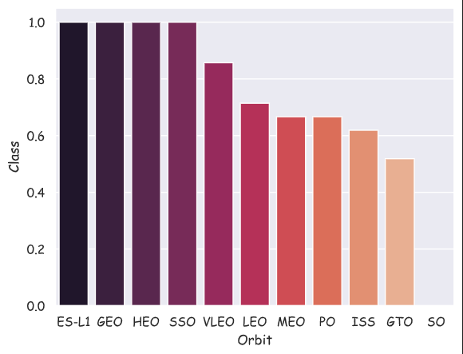
Success Rate vs. Orbit Type
This chart shows the success rate for each orbit. Orbits ES-L1, GEO, HEO, and SSO has the highest success rates among all orbits.

Slide 19
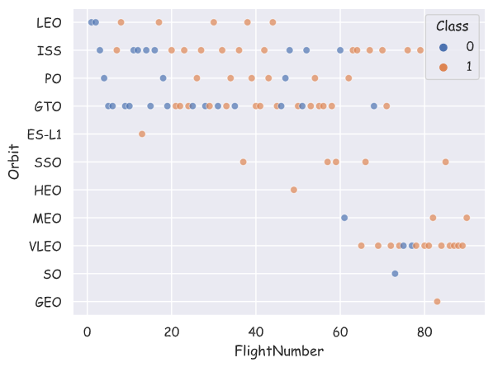
Flight Number vs. Orbit Type
The chart here shows the success rate for each orbit. You would notice that the more the number of flights for each orbit the lesser the success rate.

Slide 20
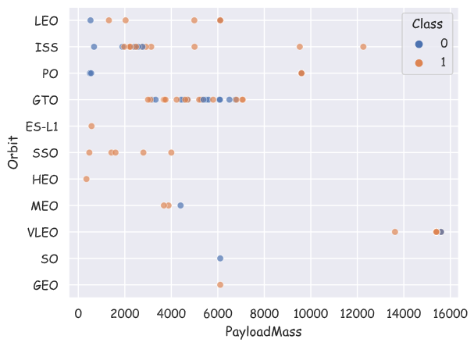
Payload vs. Orbit Type
This chart shows the payload mass for each orbit type.

Slide 21

Launch Success Yearly Trend
This chart shows the trend of the success and the failure rates for each year. We can see a markedly increase of the success rate from 2013 and a sharp drop between 2017 and 2018.

Slide 22
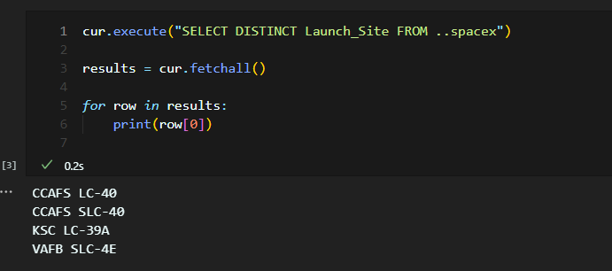
All Launch Site Names
The query shows the different sites names. The distinct sites names were gotten by using the ‘DISTINCT’ keyword to show the unique launch sites.

Slide 23
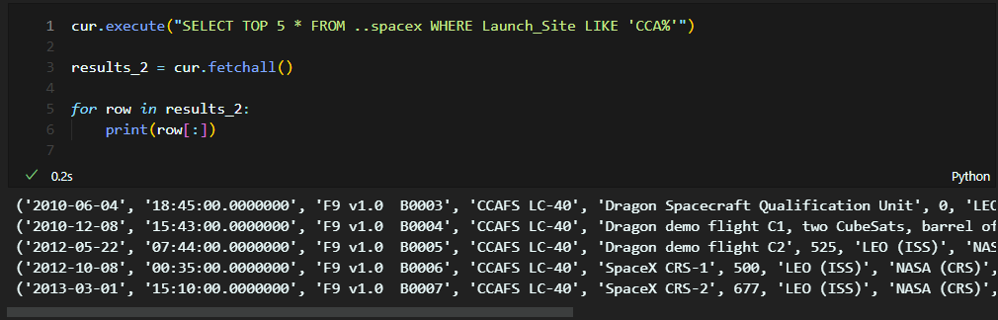
Launch Site Names Begin with 'CCA'
Here, you can see the top 5 records of the launch sites that starts with ‘CCA’. I used the ‘TOP’, ‘WHERE’, and ‘LIKE’ keywords to get this information.

Slide 24
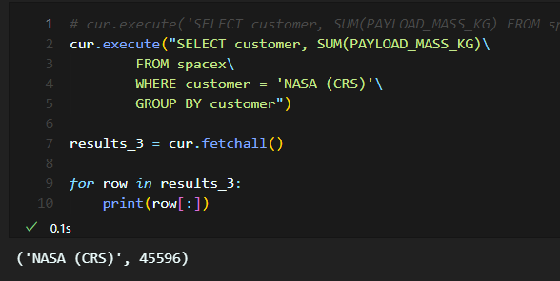
Total Payload Mass
This screenshot shows the total payload mass carried by boosters launched by NASA (CRS). The total payload mass is 45,596kg.

Slide 25
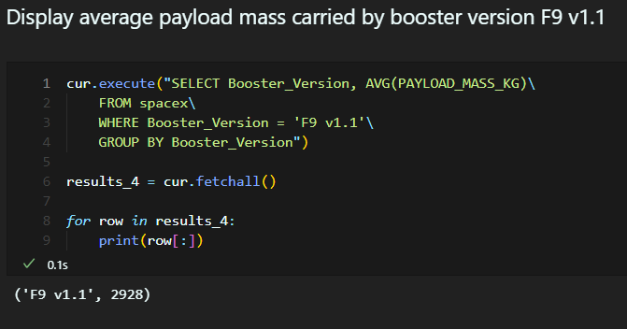
Average Payload Mass by F9 v1.1
This shows the average payload mass by F9 v1.1 booster which is 2928.

Slide 26
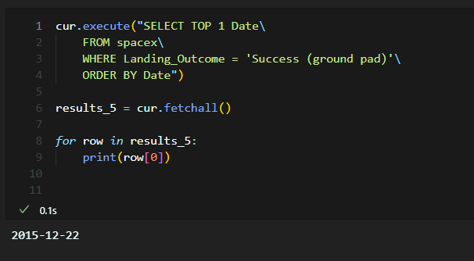
First Successful Ground Landing Date
This shows the data for the first successful landing on the ground pad. The date is shown to be 2015-12-22

Slide 27
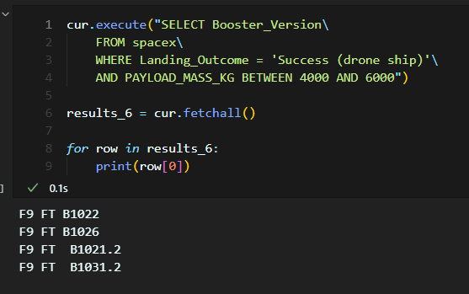
Successful Drone Ship Landing with Payload between 4000 and 6000
This shows the boosters which have successfully landed on a drone ship with a payload mass between 4000 and 6000.

Slide 28
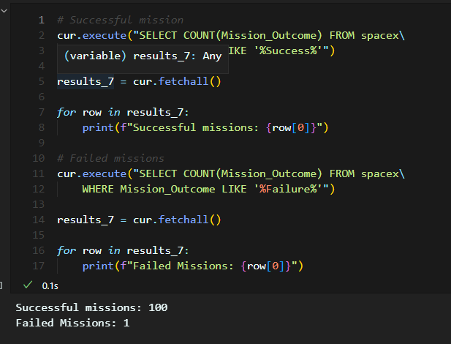
Total Number of Successful and Failure Mission Outcomes
This shows the number of successful and failed mission outcomes. Here, we have 100 successful missions and just 1 failed missions.

Slide 29
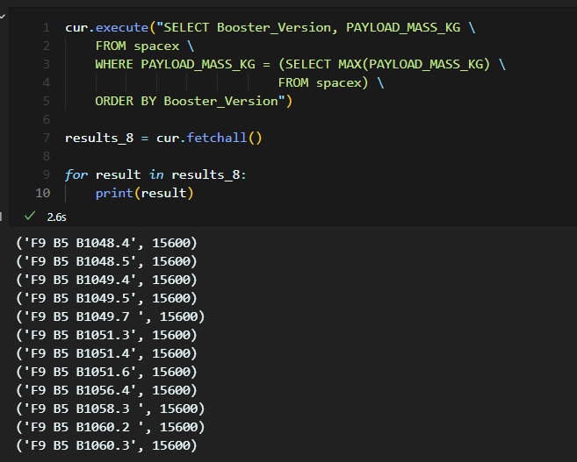
Boosters Carried Maximum Payload
This shows the boosters that carried the maximum payload. We have 12 of them listed.

Slide 30
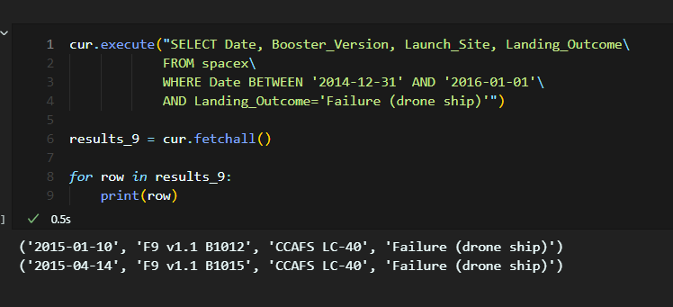
2015 Launch Records
This shows the launch records for 2015. Here, we have just 2 records from 2015.

Slide 31
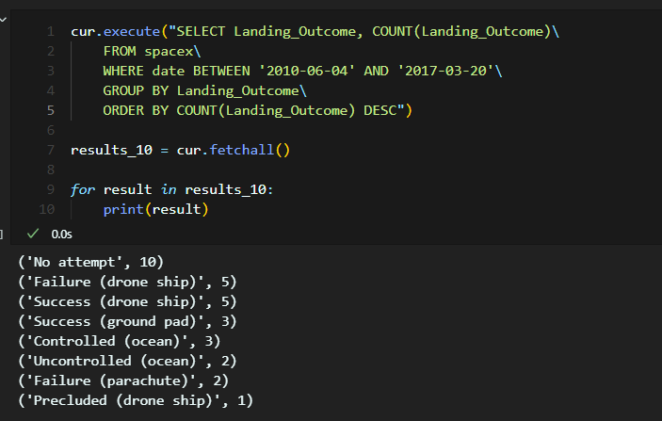
Rank Landing Outcomes Between 2010-06-04 and 2017-03-20
This shows the count of successful landing outcomes between 04-06-2010 and 20-03-2017.

Slide 32

Section 3

Slide 33
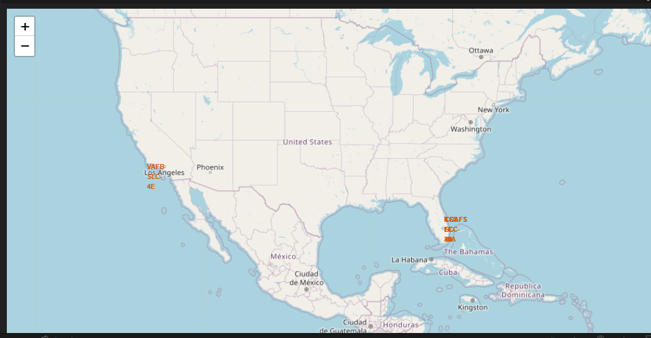
Launch Sites

Slide 34
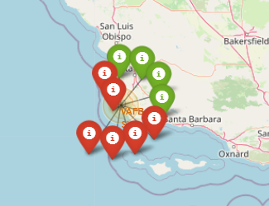
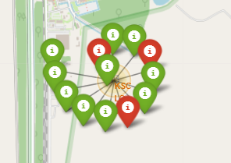
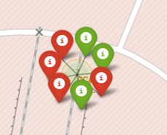
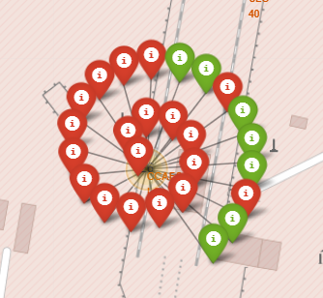
Successful and Failed Launches at different launch sites
The following screenshots shows the different launch sites with successful launches in green and failed launches in red.
KSC LC 39A
VAFB SLC 4E
CCAFS SLC40
CCAFS LC 40

Slide 35
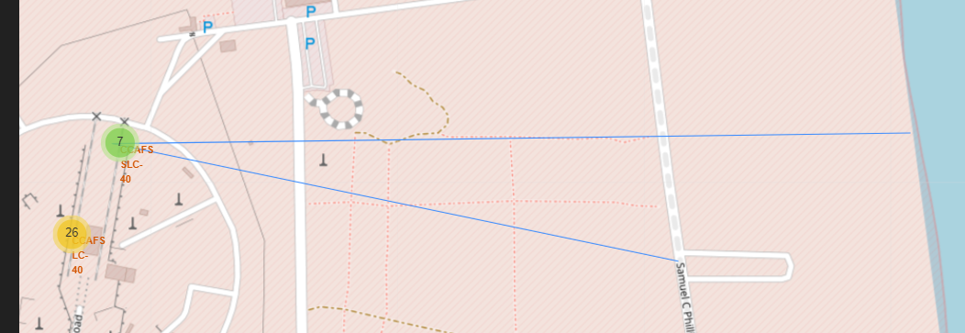
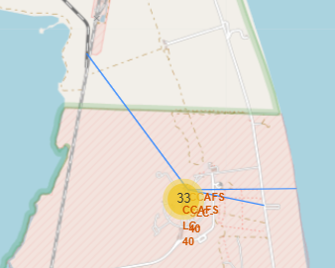
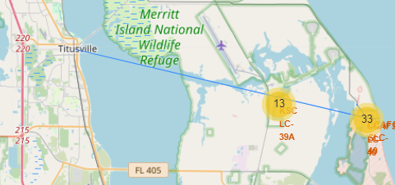
Launch Sites to Markers distance

Slide 36

Section 4

Slide 37
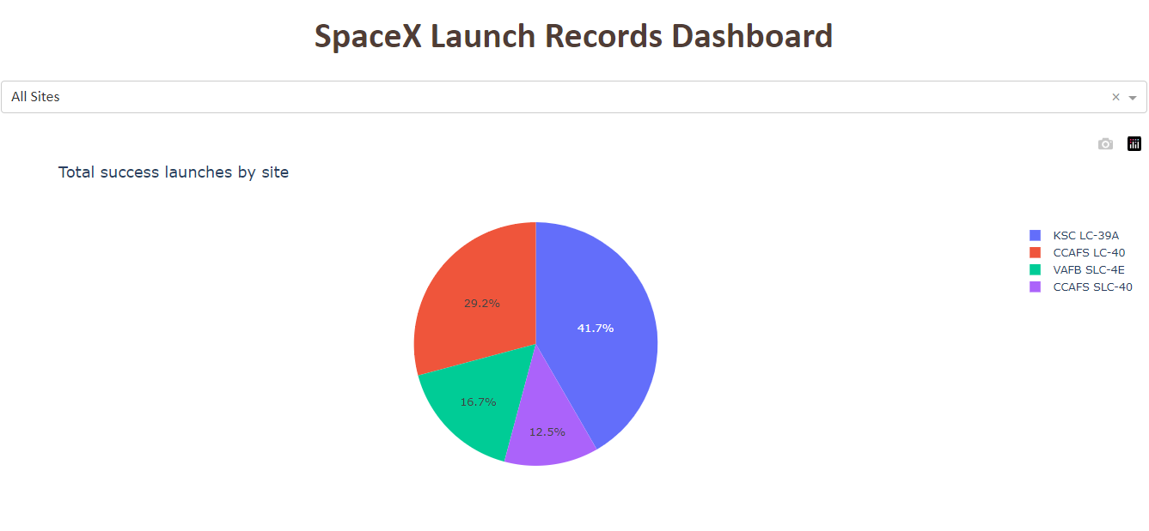
Total success launches by sites

Slide 38
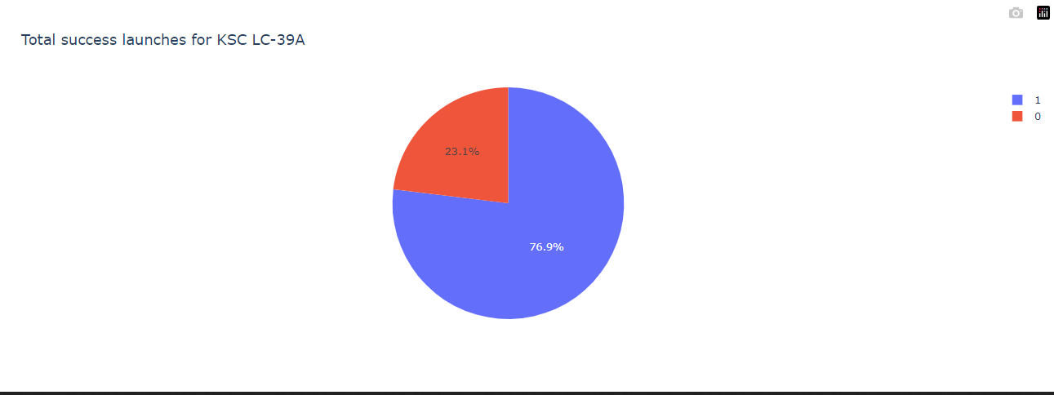
Success ratio for KSC LC-39A

Slide 39
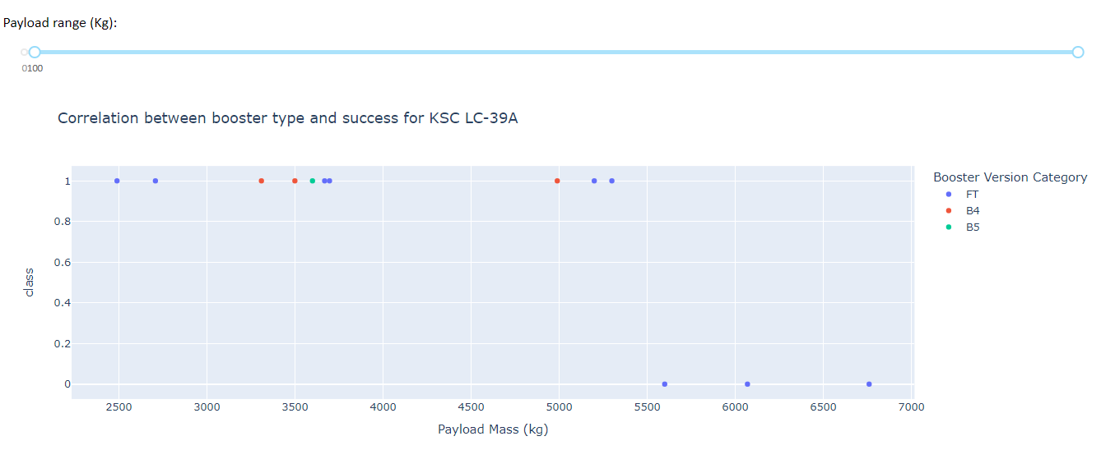
Payload vs Launch outcome scatter plot

Slide 40

Section 5

Slide 41
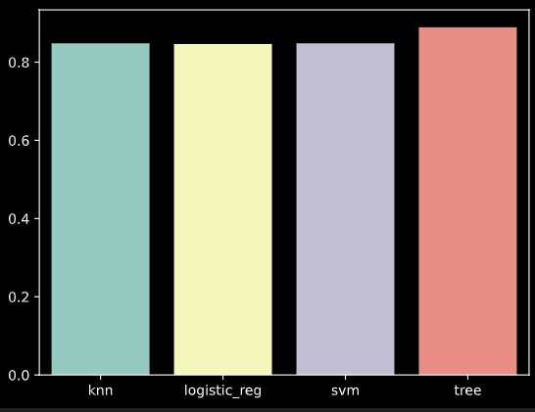
Classification Accuracy
From the chart, you can see that out of all the classification algorithms, the decision tree algorithm had the best accuracy score.

Slide 42
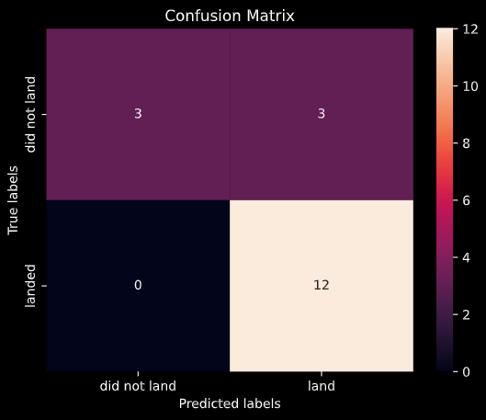
Confusion Matrix
The confusion matrix was plotted for the best performing model (Decision tree classifier) showing the True Positives, False positives, True Negatives and False Negatives.
True Positives: 12
True Negatives: 3
False Positives: 3
False Negatives: 0

Slide 43
Conclusions
The larger the flight amount at a launch site, the greater the success rate at a launch site.
Launch success rate started to increase in 2013 till 2020.
Orbits ES-L1, GEO, HEO, SSO, VLEO had the most success rate.
KSC LC-39A had the most successful launches of any sites.
The Decision tree classifier is the best machine learning algorithm for this task.

Slide 44


